Slide 1

Amazon Sales and Customer Insights Analysis
An end-to-end data analytics project leveraging SQL, Python, and Power BI to transform raw e-commerce data into actionable business intelligence and strategic insights.
Presented by: Shubham Makkar | Imarticus Learning, Delhi | November 2025

Slide 2

Project Overview
Strategic Focus
This comprehensive analytics initiative examines Amazon's synthetic sales ecosystem to uncover critical patterns in customer behavior, product performance trends, and revenue optimization opportunities.
By integrating advanced data processing techniques with interactive visualization, we transform complex transactional data into clear, strategic business recommendations.

Slide 3

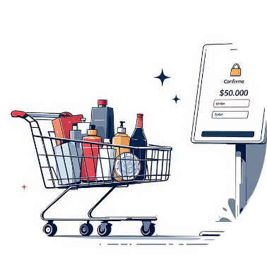



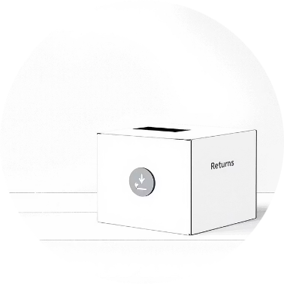
Dataset Description
The dataset used is synthetic, representing Amazon’s real-world e-commerce operations. It contains six interrelated tables connected via unique IDs (CustomerID, OrderID, ProductID).
Customers
Orders
Products
Transactions
Details about individual customers including their contact information and demographics.
Comprehensive information for each order placed, including dates and estimated delivery times.
Detailed specifications and pricing for all items available in the e-commerce catalog.
Records of all payment activities linked to specific orders, including payment methods.
Key Columns: cid, cname, city, age, address, contact, email
Key Columns: oid, cid, pid, order_date, order_time, ETA
Key Columns: pid, pname, price, desc
Key Columns: oid, payment_mode
Feedback
Refund
Customer-submitted ratings and comments regarding product quality and delivery service.
Information pertaining to product returns and exchanges, including reasons and dates.
Key Columns: oid, prod_rating, delivery_rating
Key Columns: orderid, Return_Type, Reason, return_date

Slide 4





Dataset & Methodology
Comprehensive Dataset
Data Cleaning
Multi-dimensional data including customers, orders, products, transactions, refunds, and feedback ratings
Python-based preprocessing to ensure data quality, consistency, and analytical readiness
SQL Analysis
Power BI Dashboards
MySQL queries extracting key metrics, patterns, and customer behavior insights
Interactive visualizations converting complex data into intuitive business intelligence

Slide 5
Problem Statement & Key Insights from Data
Analyzing key pain points and areas for improvement identified from the Amazon sales data.
Customer Loyalty Gap
Problematic Product Performance
Regional Payment Disparities
Delhi, Pune, and Kolkata have the highest customer numbers, yet repeat purchase rates are consistently low. This indicates a significant opportunity to boost customer loyalty.
While "Mi Power Bank Air" is a top seller, "Relme Power Bank" (40%) and "Sukam Mixer Grinder" (37.5%) suffer from exceptionally high refund rates, signaling potential product quality or description discrepancies.
Credit Card (31.26%) and UPI (30.86%) are leading payment methods, but city-specific preferences, like UPI's heightened popularity in Delhi and Mumbai, demand localized payment strategies.
Elevated Return & Exchange Rates
Moderate Satisfaction Levels
Noida leads with a 59.14% refund rate, and Delhi with a 56.52% exchange rate. These figures strongly suggest underlying issues with product quality or the delivery process in these key regions.
Average product ratings of 2.99 and delivery ratings of 3.00 point to overall moderate customer satisfaction. There's a clear need for targeted initiatives to enhance both product and service experience.

Slide 6
Project Objectives
Our primary goals are to extract actionable insights from the Amazon sales data and translate them into strategic recommendations.
1
Customer Behavior Analysis
Analyze customer purchase behavior to identify top-performing cities and demographic segments.
2
Sales Performance Tracking
Measure key sales metrics such as order trends, total revenue, and average order value (AOV) over time.
3
Product Performance Evaluation
Identify products experiencing high refund and exchange rates to pinpoint quality issues or misleading descriptions.
4
Payment Method Insights
Study payment mode preferences across different cities to optimize payment gateway strategies.
5
Customer Satisfaction Assessment
Evaluate product and delivery ratings to quantify overall customer satisfaction and identify areas for service improvement.
6
Interactive Data Visualization
Develop comprehensive and interactive Power BI dashboards to visualize all gathered insights for easy interpretation and decision-making.

Slide 7






Key Performance Indicators (KPIs)
A focused summary of the critical metrics used to measure performance across different facets of Amazon's e-commerce operations.
Customers
Orders
Total Customers, Repeat Rate, New Customers per Month
Total Orders, Total Revenue, Average Order Value (AOV)
Products
Transactions
Top Products by Revenue, Refund Rate by Product
Payment Mode Share across different methods
Refunds
Feedback
Refund vs. Exchange Ratio, Refund Rate by City
Average Product and Delivery Rating

Slide 8
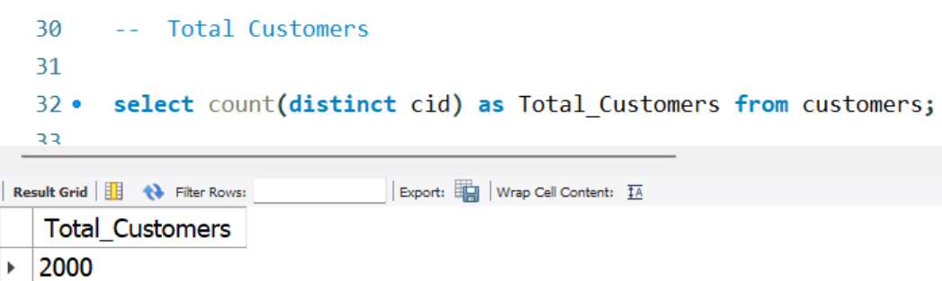
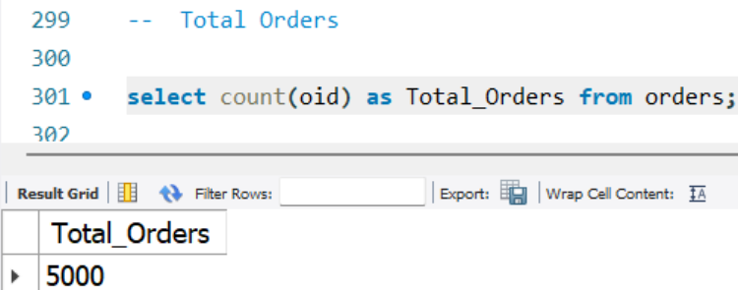

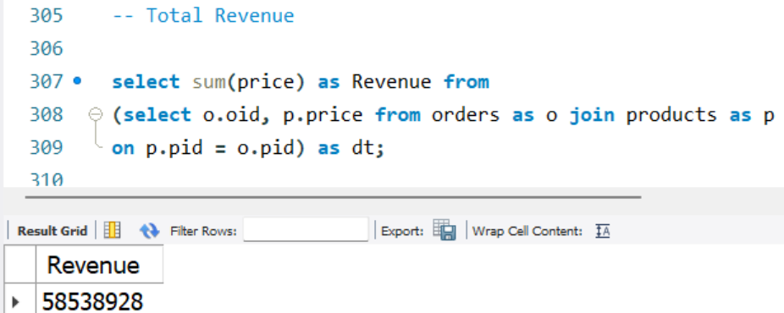
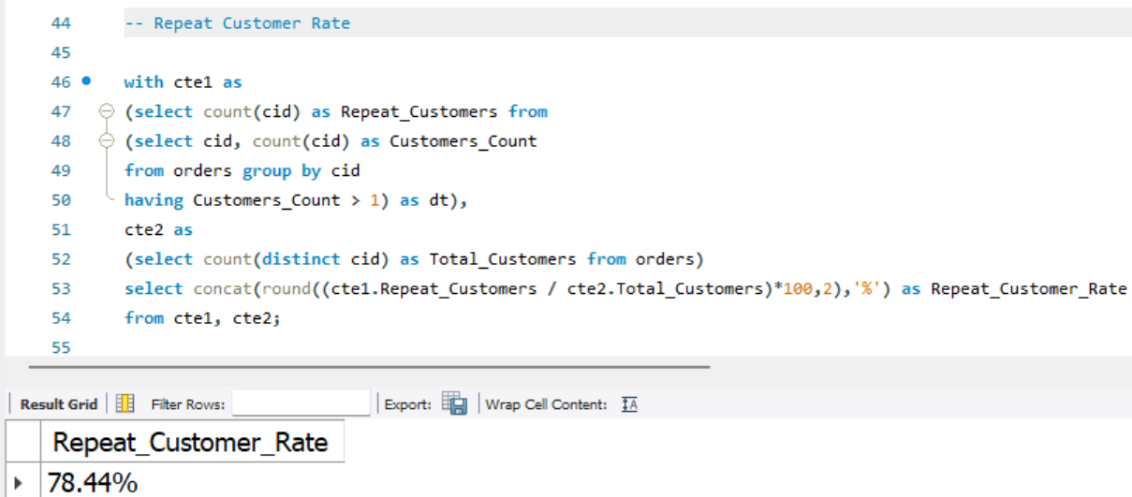
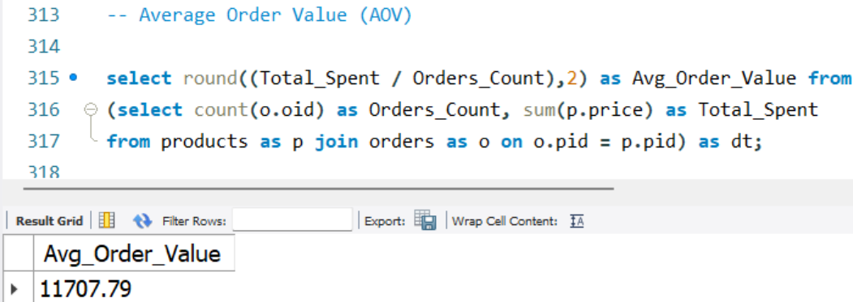
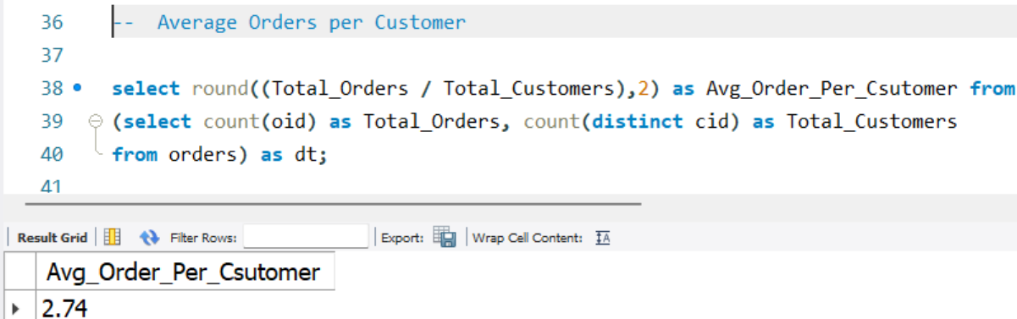
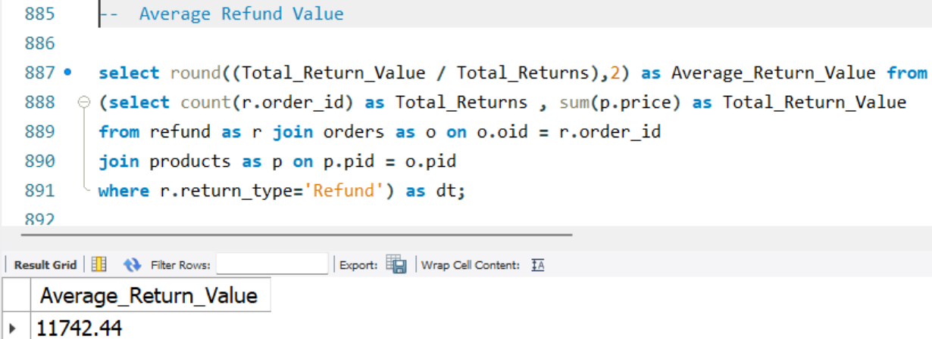
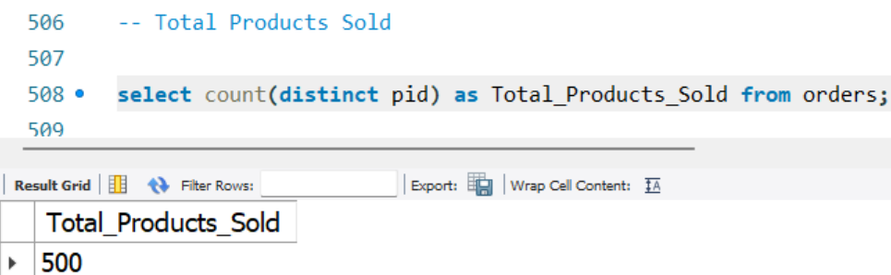
SQL KPI’s
Total Customers
Total Orders
Repeat Customer Rate
Total Revenue
Average Order Per Customer
Average Order Value
Total Products Sold
Average Return Value

Slide 9
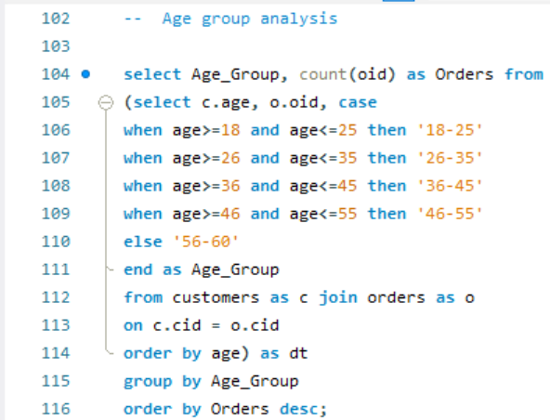
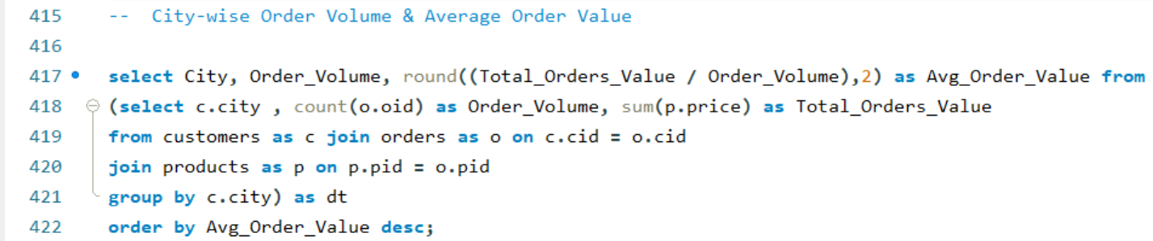
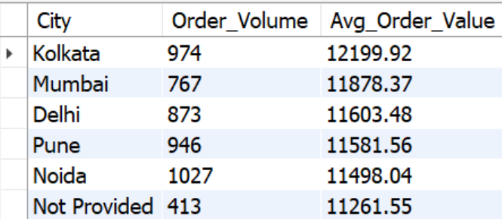
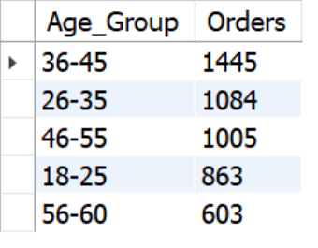
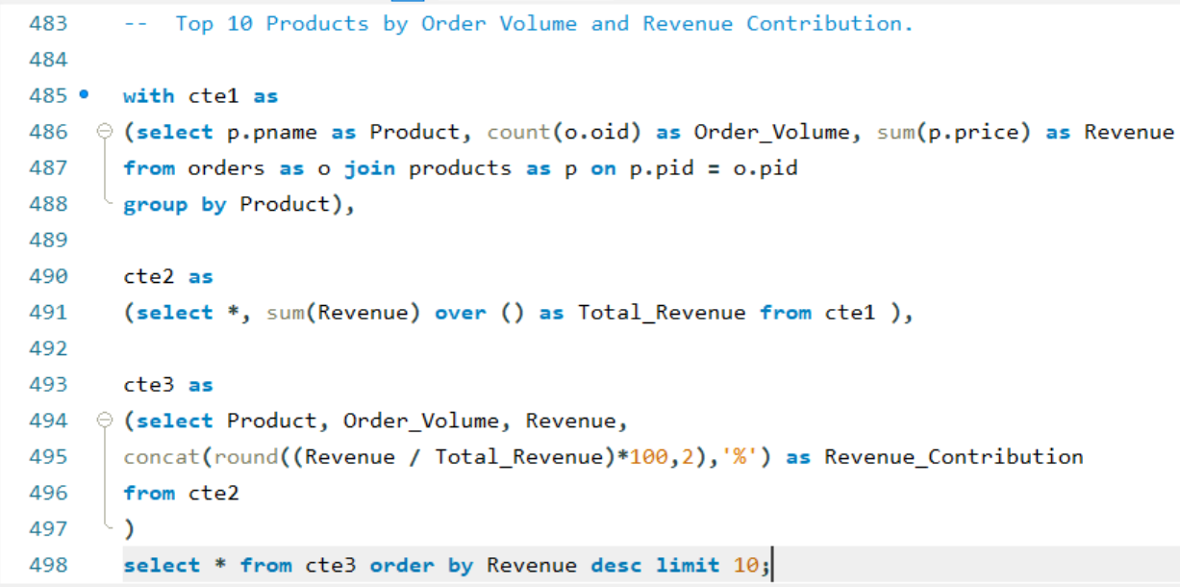
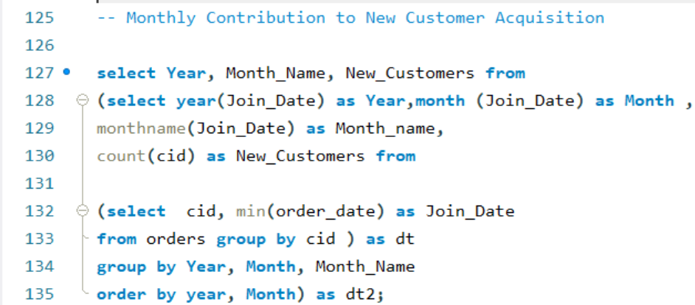
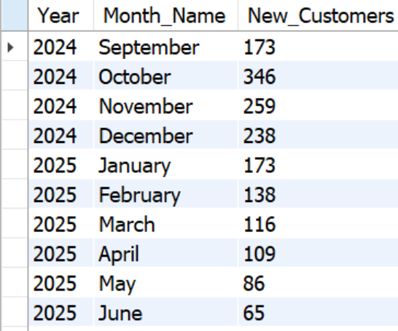
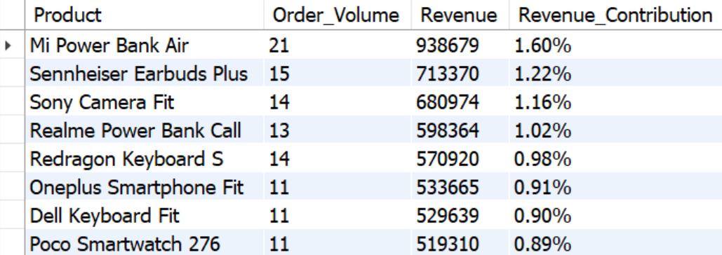
SQL Insights
Age Group Analysis
City wise Order Volume
& Average Order Volume
Monthly Contribution to New Customers
Top 10 Products by Order Volume & Revenue Contribution

Slide 10
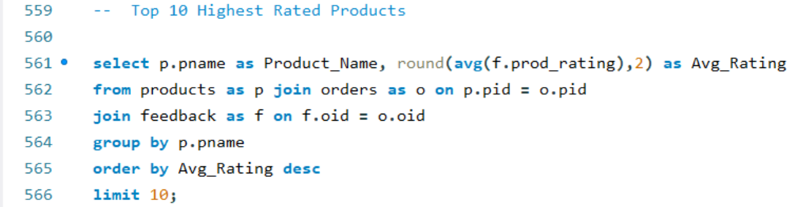
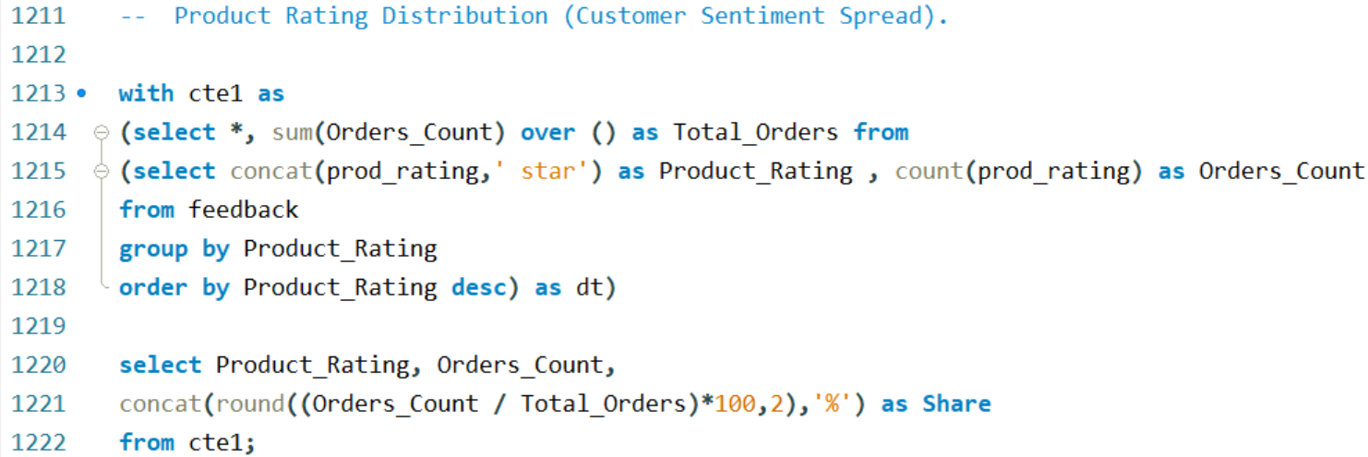
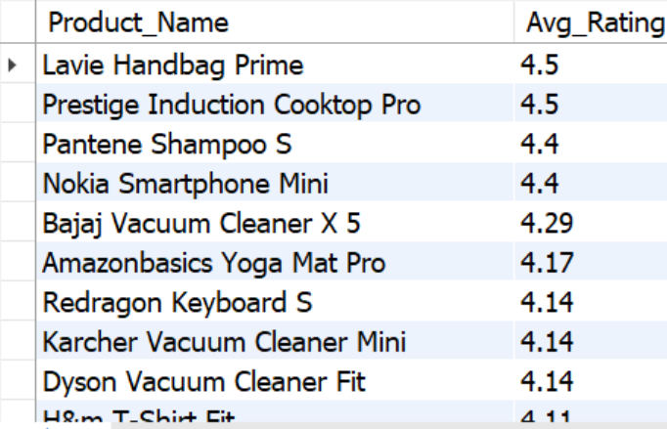
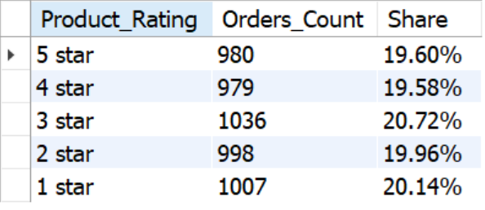
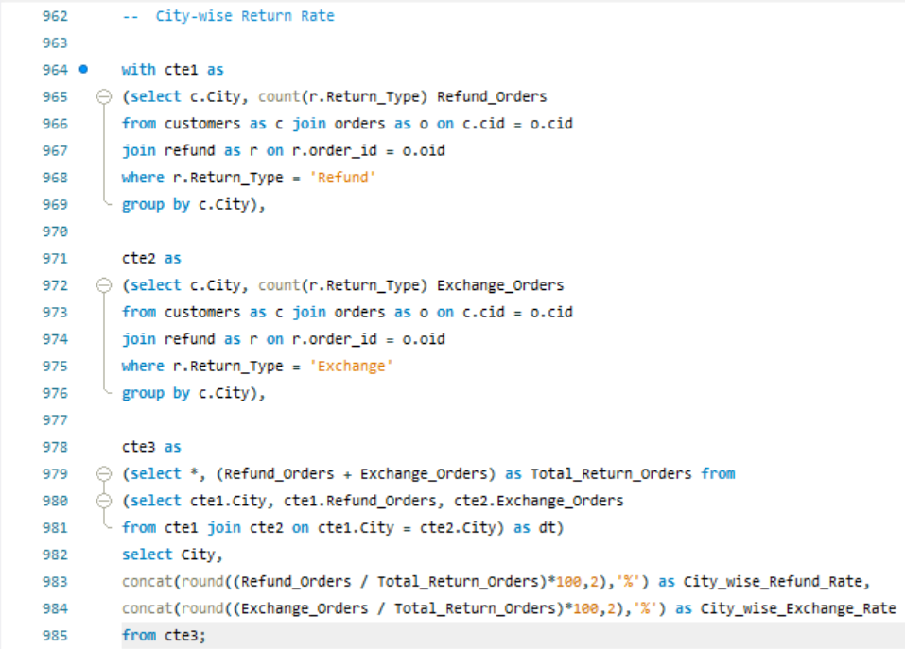
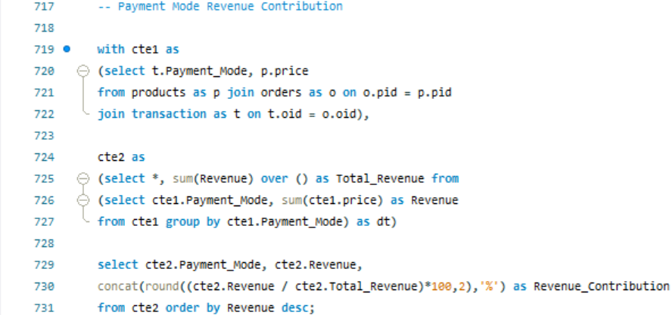
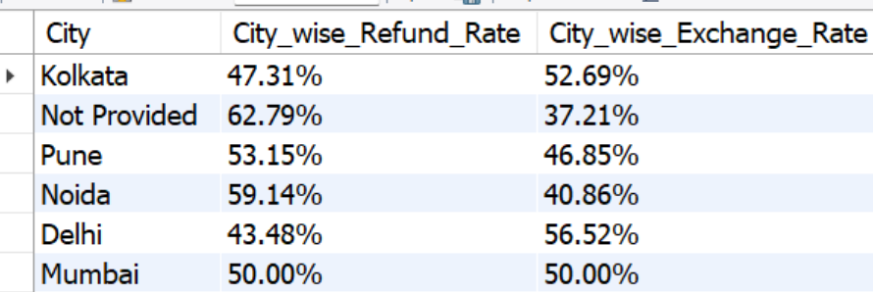
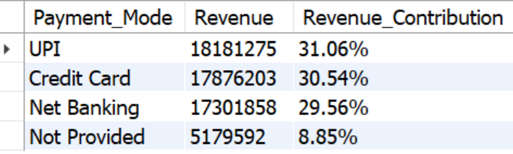
SQL Insights
Top 10 Highest Rated Products
Product Rating Distribution
Payment Mode Revenue Contribution
City wise Return Rate

Slide 11






Dashboard Overview
Our interactive Power BI dashboards are structured to provide a comprehensive view of Amazon's e-commerce performance, covering key areas from customer behavior to product feedback.
Customer Analysis
Insights into customer demographics and purchase patterns.
Order Data Analysis
Tracking order trends, revenue, and average order value.
Product Analysis
Performance metrics, including top sellers and refund rates.
Transaction Analysis
Payment method preferences and transactional summaries.
Refund Analysis
Examination of return and exchange rates by product and region.
Feedback Analysis
Assessment of product and delivery satisfaction scores.

Slide 12
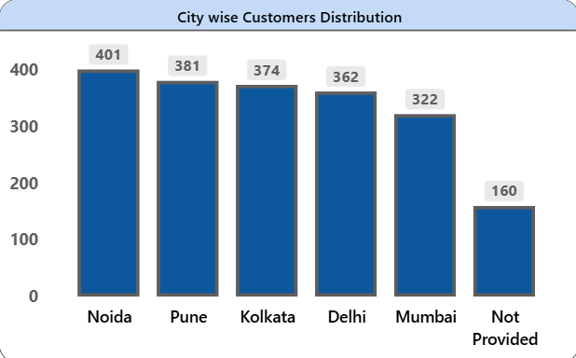
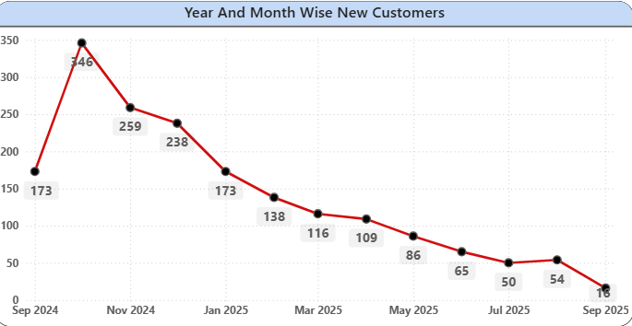
Customer Analysis
The bar chart shows that Noida has the highest number of customers (401), followed by Pune (381) and Kolkata (374). These cities contribute the most to Amazon’s customer base, indicating stronger engagement and sales potential in metro areas.
The line chart illustrates the trend of new customer registrations over time. The number of new customers peaked in October 2024 (346) and gradually declined afterward, showing reduced customer acquisition in early 2025.

Slide 13
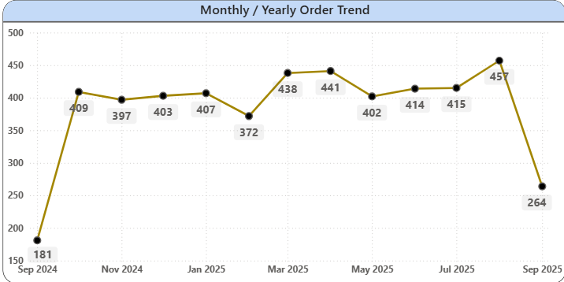
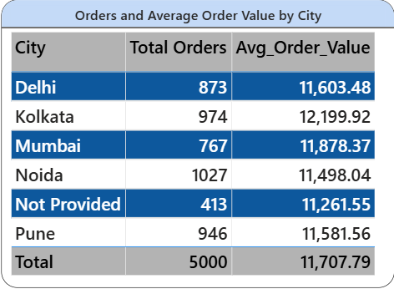
Order Data Analysis
Orders stayed steady between 400–450 per month with peaks in April, May, and August. A drop in September 2025 indicates seasonal decline or period end.
Noida has the highest orders (1,027), while Kolkata shows the highest average order value (₹12,199), indicating higher spending per customer.

Slide 14
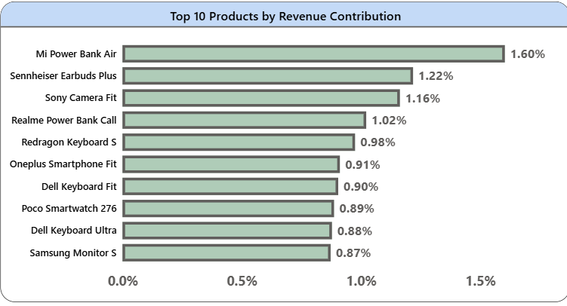
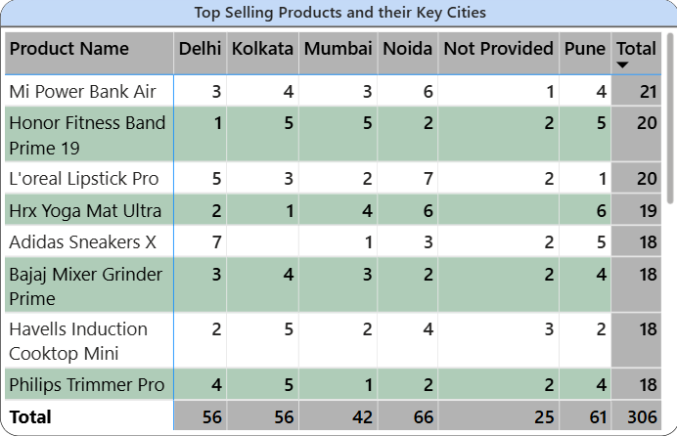
Product Analysis
‘Mi Power Bank Air’ is the top revenue generator (1.6%), followed by ‘Sennheiser Earbuds Plus’ and ‘Sony Camera Fit’. Most of the top products are electronics, showing strong sales in the gadgets and accessories category.
‘Mi Power Bank Air’ and ‘Honor Fitness Band Prime 19’ are the most popular products across multiple cities. Noida records the highest product sales (66), showing strong regional demand.

Slide 15
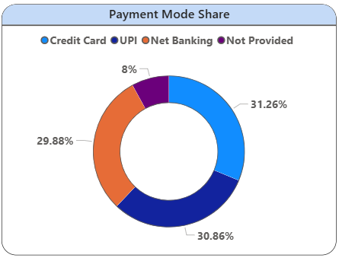
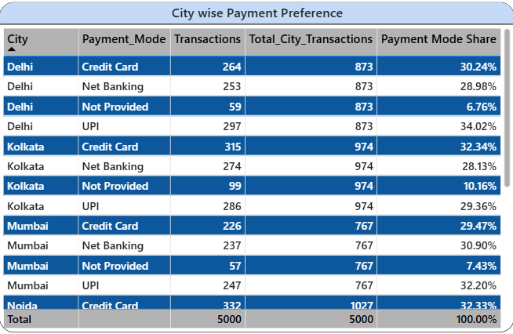
Transaction Analysis
Credit Card (31.26%) and UPI (30.86%) are the most preferred payment modes, followed closely by Net Banking (29.88%). This highlights a nearly even split between card and digital payments among customers.
City-wise analysis shows that UPI is more popular in Delhi and Mumbai, while Credit Cards are widely used in Kolkata and Noida.

Slide 16
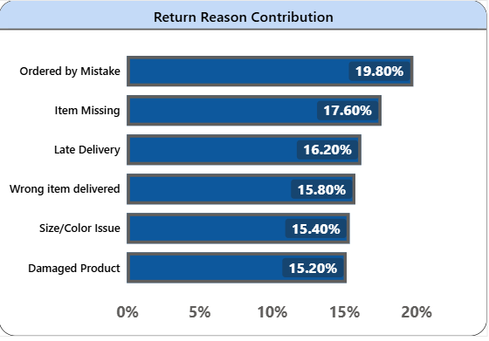
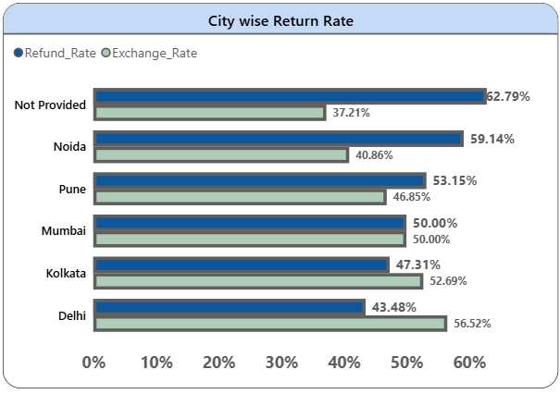
Refund Analysis
Most returns occur because customers ordered by mistake (19.8%), followed by missing items (17.6%) and late deliveries (16.2%).
Noida shows the highest refund rate (59.14%), followed by Pune (53.15%) and Mumbai (50%). Delhi has the highest exchange rate (56.52%), indicating more customers opting for replacements rather than refunds.

Slide 17
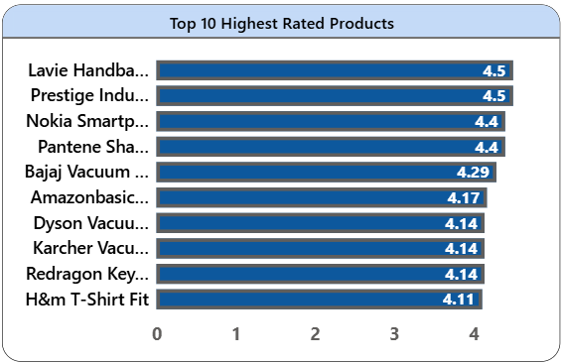
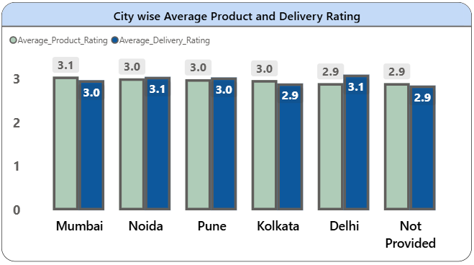
Feedback Analysis
‘Lavie Handbag Pro’ and ‘Prestige Induction Cooktop’ are the highest-rated products (4.5). Most top-rated items belong to electronics and personal care categories, reflecting good product satisfaction.
Overall product and delivery ratings are around 3.0 across cities. Noida and Delhi show slightly higher delivery satisfaction (3.1), while Kolkata has the lowest ratings.

Slide 18





Business Recommendations
Based on our analysis, we propose the following strategic recommendations to enhance Amazon's e-commerce performance and customer satisfaction.
Targeted Marketing
Concentrate marketing efforts on top-performing cities to maximize impact and reach relevant customer segments.
Loyalty Programs
Implement robust loyalty programs to incentivize repeat purchases and foster stronger customer retention.
Product Quality Review
Conduct thorough investigations into products with high refund rates to address underlying quality issues or misaligned descriptions.
Localized Payment Offers
Promote specific UPI offers and benefits in metro cities where this payment method demonstrates higher popularity.
Enhanced Delivery Experience
Focus on improving the delivery process to boost customer ratings and overall satisfaction with service.

Slide 19
Conclusion & Learnings
This project has been a valuable journey through the Amazon sales data, yielding significant insights and skill development.
Successfully completed an end-to-end e-commerce data analysis pipeline, from raw data to actionable recommendations.
Gained hands-on experience and strengthened proficiency in key data tools including Python, MySQL, and Power BI.
Derived critical insights into customer behavior, sales trends, refund patterns, and overall satisfaction, highlighting areas for strategic intervention.
Strengthened analytical, data visualization, and storytelling skills through the comprehensive presentation of complex findings.

